Slide 1
Legacy .NET solutions upgrade
Short story about one project

Slide 2

Disclaimer

Slide 3

The beginning
Client’s company IT department : we are scheduling OS update on all available development boxes on Q1 2015:
Better performance
Improved security
Less-intrusive updates ©
Better maintainability
Notably small upgrade costs
(Chance to replace some old hardware along the way?)

Slide 4

The beginning
Management : looks nice, but our Product has few legacy solutions in it, will it work how much will it cost?

Slide 5

The beginning
Developers: dunno, who knows? There is a need to do an investigation and assessment

Slide 6




Preamble

Slide 7


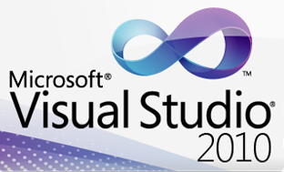




Preamble
.NET 2.0
Windows Forms 2.0
Visual Studio 2010
Microsoft Moles 0.94.51023.0 (10/23/2010)
Infragistics NetAdvantage for Windows Forms 2007 Volume 3 CLR20_HotFix_1049
pdfTron .NET 1.1 (???)
LeadTools v15.0.0.1 (2006)
*

Slide 8
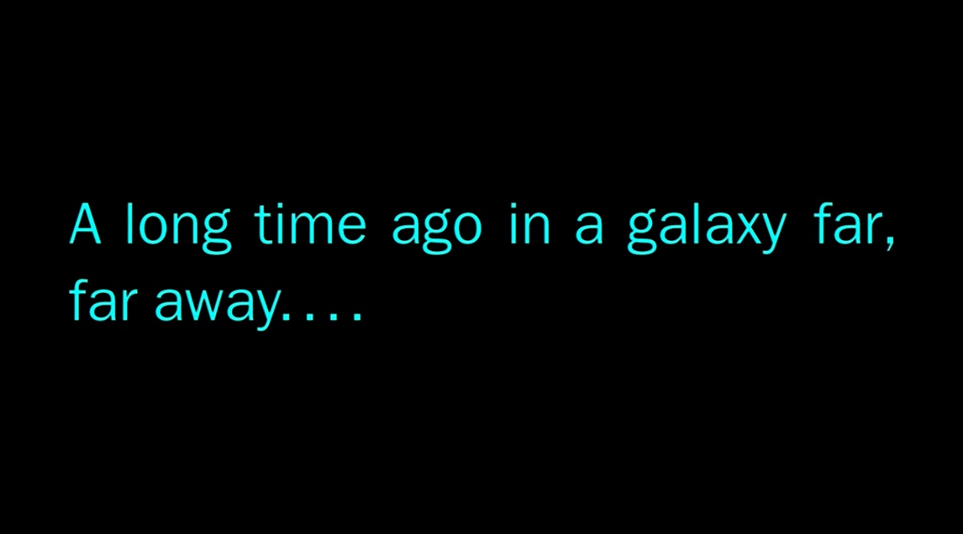
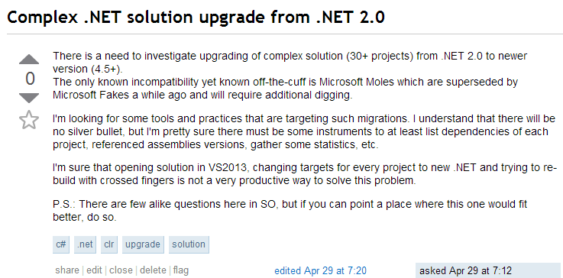
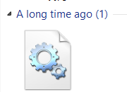
Analysis

Slide 9

Analysis
Changes draft:
Windows 7 -> Windows 8.1
.NET 2.0 -> .NET 4.5
Visual Studio 2010 -> Visual Studio 2013
Microsoft Moles -> Microsoft Fakes
Infragistics 2007 -> Infragistics 2014 (*)
pdfTron -> OSS analog (*)
LeadTools -> OSS analog (*)

Slide 10
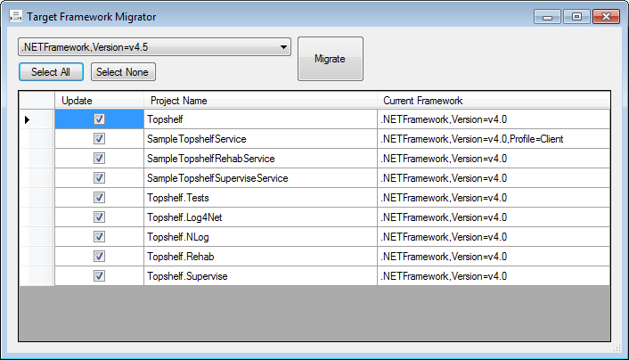
Problems
“Zero stage” expenses
No .NET 2.0 in Windows 8.1
Visual Studio 2013 licensing (*)
Incompatibility of “new” and “old” solutions, manual Moles to Fakes migration (**)
Infragistics – 13 versions skipped, lost license
No refactoring planned
Budgeting issues (no visible ROI from libraries upgrade)
Rollout/delivery
Target Framework Migrator
(http://visualstudiogallery.msdn.microsoft.com/47bded90-80d8-42af-bc35-4736fdd8cd13)

Slide 11
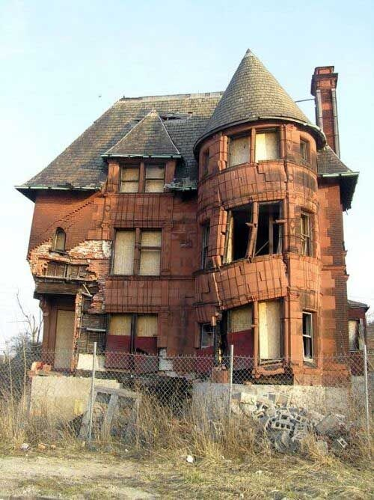
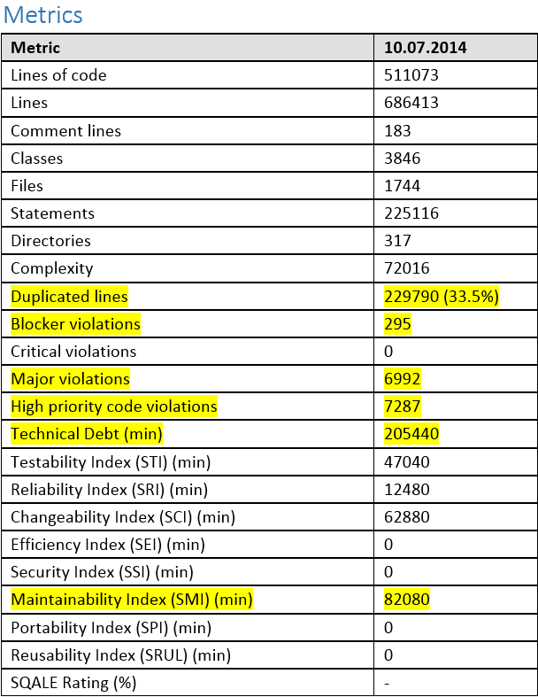
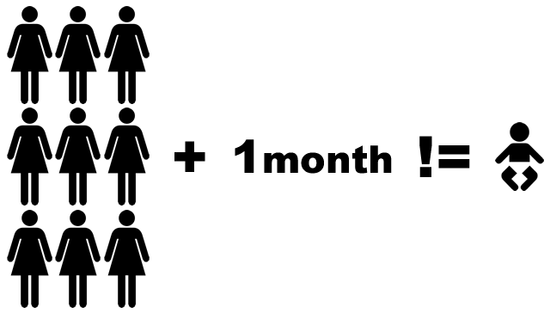

Problems Pt.2
The solution itself:
26 Framework projects
8 modules
3 applications
~1000 unit tests
Private accessors

Slide 12
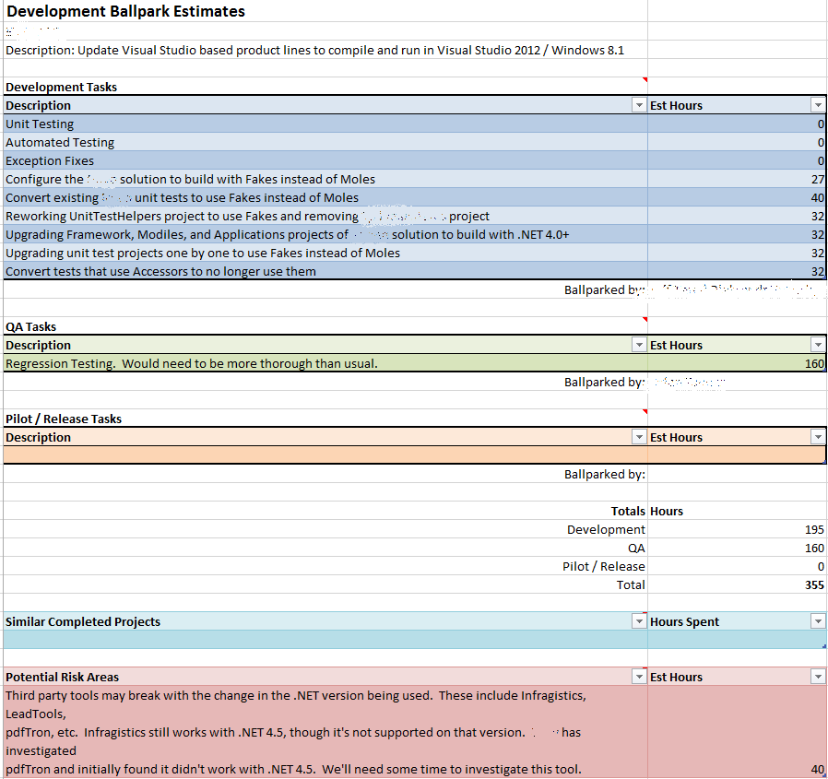
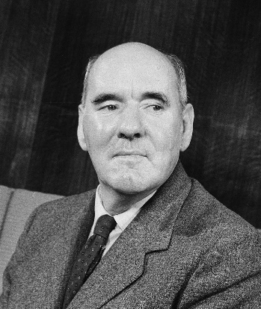
Ballpark
355
Work expands so as to fill the time available for its completion (Cyril Northcote Parkinson)

Slide 13
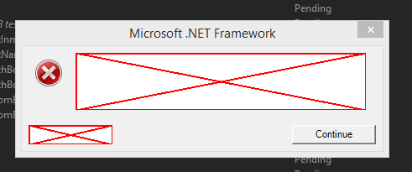




(99) Problems
“Runtime errors”
Build scripts rewriting
MSTest vs. VSTest problem
Installation of VS2013 on build machine
Randomly failing unit tests duo to coupling and context preserving
Strange behavior of multiple versions of Product after merge
CI builds performance issues

Slide 14
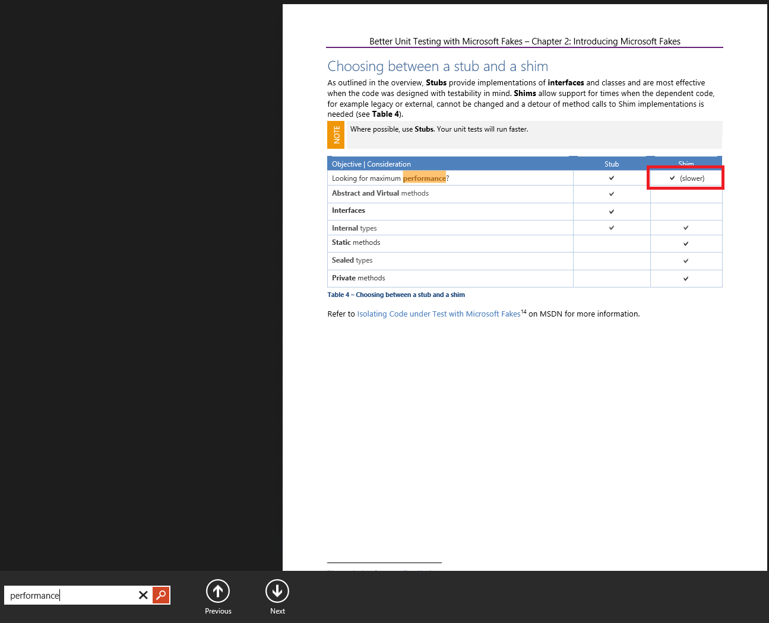
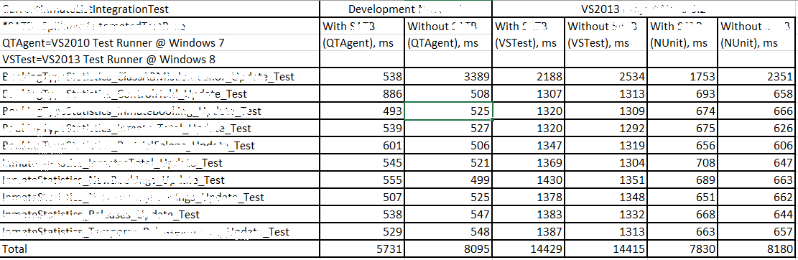
(99) Problems
p.16 of Better Unit Testing with
Microsoft Fakes (RTM).pdf

Slide 15
/// <summary>
/// Initializing unit test infrastructure for particular test.
/// </summary>
public void InitializeInfrastructure()
{
if (CurrentTestMethodRequiresShimsContext())
{
// Creating Shims context for each test because otherwise we may potentially make detours configured for one test method
// remain active for all other test methods in the class. In other words, detours and any additional state
// captured by lambdas becomes shared between all test methods. This can destabilize the test harness.
ShimsContext = Microsoft.QualityTools.Testing.Fakes.ShimsContext.Create();
OnInitializeTest();
}
else
{
// Since current test does not require shims,
// we do not create ShimsContext.
ExecuteWithoutShimsContext(OnInitializeTest);
}
}
/// <summary>
/// Checking if current test method requires ShimsContext to be created.
/// </summary>
/// <returns>True, otherwise false.</returns> public bool CurrentTestMethodRequiresShimsContext()
{
var executingTestMethod = GetType().GetMethods() .FirstOrDefault(m =>
m.GetCustomAttributes(typeof (TestMethodAttribute), false).Length > 0 &&
m.GetCustomAttributes(typeof (ShimsContextRequiredAttribute), false)
.Length > 0 && m.Name == TestContext.TestName );
return executingTestMethod != null;
}
/// <summary>
/// Executing method without ShimsContext being created.
/// </summary>
/// <param name="action">Action to execute.</param> public static void ExecuteWithoutShimsContext(FakesDelegates.Action action)
{
if (action == null)
{
throw new ArgumentNullException("action");
}
using (UnitTestIsolationRuntime.AcquireProtectingThreadContext())
{
action();
}
}
<Fakes xmlns="http://schemas.microsoft.com/fakes/2011/">
<Assembly Name="mscorlib" Version="4.0.0.0"/>
<ShimGeneration>
<Clear/>
<Add FullName="System.DateTime"/>
<Add FullName="System.IO.Path"/>
<Add FullName="System.IO.File"/>
<Add FullName="System.IO.Directory"/>
<Add FullName="System.Collections.ObjectModel.Collection"/>
<Add FullName="Microsoft.Win32.RegistryKey"/>
<Add FullName="System.IO.StreamReader"/>
</ShimGeneration>
</Fakes>

Slide 16

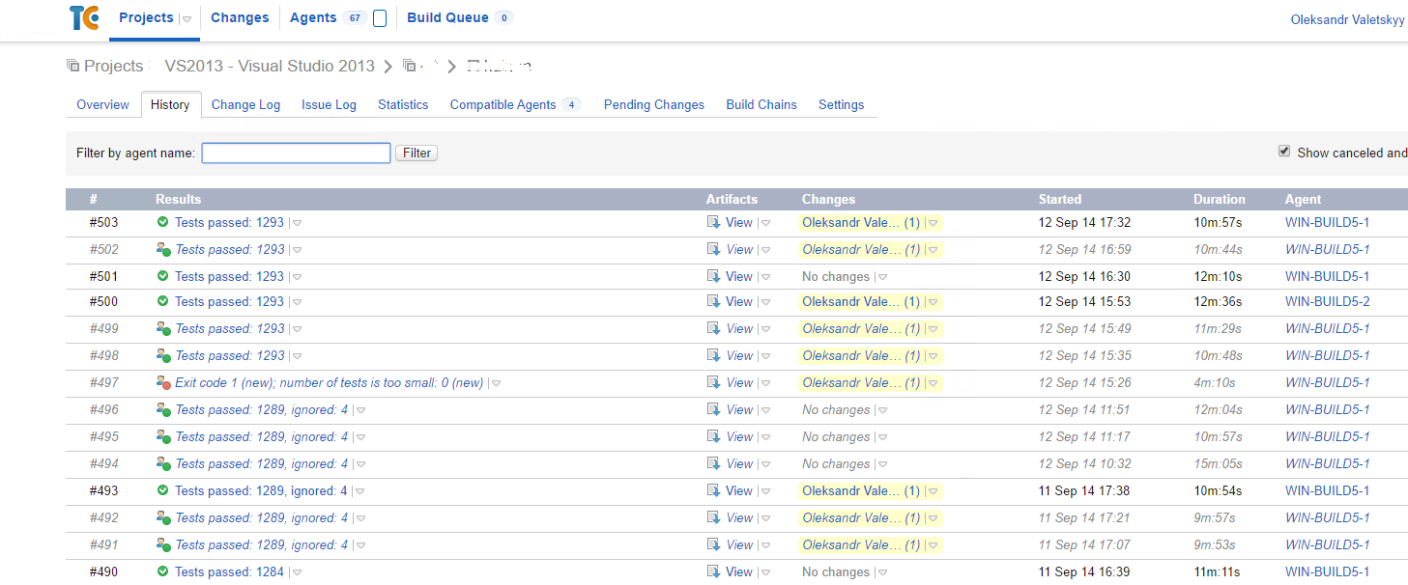
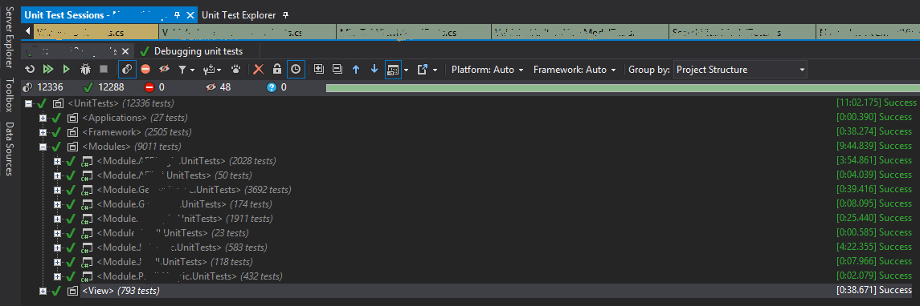

Outcomes

Slide 17

Questions?

Slide 18

Thank you!

